Slide 1

Fake Degree Detection
App to prevent fraudulent educational degrees

Slide 2
Technologies used
Blockchain :- Solidity , Ethereum , Web3.js , Ether.js
JavaScript :- NodeJS , ReactJS
CSS

Slide 3

Blockchain
Decentralized Ledger: Blockchain is a decentralized and distributed digital ledger that records transactions across a network of computers. Unlike traditional centralized systems, where a single authority maintains the ledger, blockchain allows multiple parties to maintain and validate the ledger collectively. This decentralization enhances transparency and security.
Immutable and Transparent: Once data is added to a blockchain, it becomes nearly impossible to alter or delete. Each block in the chain contains a cryptographic reference to the previous block, creating a chain of interlinked records. This immutability ensures the integrity of the data and fosters trust among participants. Additionally, all transactions are transparent and can be viewed by anyone on the network, promoting accountability.

Slide 4
Cryptography and Security: Blockchain relies heavily on cryptographic techniques to secure data and transactions. Each participant on the network has a pair of cryptographic keys (public and private) that authenticates their identity and allows them to interact with the blockchain. This cryptographic security ensures the privacy of transactions and protects against fraud and unauthorized access.
Smart Contracts: Blockchain platforms like Ethereum support smart contracts, self-executing contracts with the terms of the agreement directly written into code. Smart contracts automate and enforce the execution of contractual agreements without the need for intermediaries. They can be used in various applications, including supply chain management, financial services, and more.
Use Cases Beyond Cryptocurrency: While blockchain technology gained prominence with cryptocurrencies like Bitcoin, its applications extend far beyond digital currencies. It is being used in industries such as supply chain management, healthcare, voting systems, real estate, and more. Blockchain's ability to provide trust, security, and transparency has the potential to revolutionize various sectors by reducing fraud, streamlining processes, and reducing costs.

Slide 5

Problem statement
In today's world, education and qualifications are important. But there's a big problem: more and more people are getting fake degrees and certificates. These fake qualifications are a big problem because they hurt the reputation of real schools and can cause problems for employers and students.
The way we usually check if someone's degree is real is not very good. It's slow and can be tricked easily.
So, we have a project called "Fake Degree Detection Based on Blockchain." This project wants to use a special technology called blockchain to solve this problem. Blockchain is good for this because it keeps things very secure and can't be changed easily.

Slide 6

Here's what our project is all about:
We want to make it easy for schools & colleges to put real degrees on the blockchain. This way, everyone can check if a degree is real or fake.
We want to make a simple website or app that lets people easily show their degrees to others. It will also help keep their personal information safe.
We will make sure that people's private information is safe when they use our system.
Our system should be able to handle lots of degrees and work well as more people use it.
We'll also try to make it work with other websites and systems, so it's easy for everyone to use.
So, our project's goal is to make it easy and safe for people to check if a degree is real or fake using blockchain technology. This will help protect the reputation of real schools and colleges to make sure that employers and students can trust the qualifications they see.

Slide 7

Project description
Project Overview :
Growing concern of fake degrees undermining trust in education and employment.
Proposed solution: Utilize blockchain technology to verify academic credentials.

Slide 8

Objectives and Outcomes
Project Objectives:
Develop a secure, user-friendly blockchain system for credential verification.
Create a tamper-proof credential issuance process for institutions.
Provide a user-friendly interface for individuals.
Ensure privacy and security through advanced cryptography.
Design for scalability and integration with existing systems.
Expected Outcomes:
Reliable credential verification system.
User-friendly interface for secure qualification display.
Enhanced trust and reduced risks from fake degrees.
Improved integrity of educational institutions and employment trust.

Slide 9

Future scope
Global Adoption: Expand the solution's reach to a global scale by partnering with educational institutions, governments, and international organizations to standardize blockchain-based credential verification.
Blockchain Interoperability: Explore opportunities to make the system compatible with various blockchain platforms, ensuring interoperability and broader adoption.
AI Integration: Incorporate artificial intelligence (AI) and machine learning (ML) algorithms to enhance fraud detection and further automate the verification process.
Industry Collaboration: Collaborate with industries beyond education, such as healthcare, finance, and legal, to extend the application of blockchain-based verification to other professional qualifications.
Secure Mobile Apps: Develop dedicated mobile apps for convenient and secure access to digital credentials, enhancing the user experience.
Government Recognition: Work towards gaining recognition and support from government authorities to ensure the legal validity of blockchain-verified credentials.

Slide 10
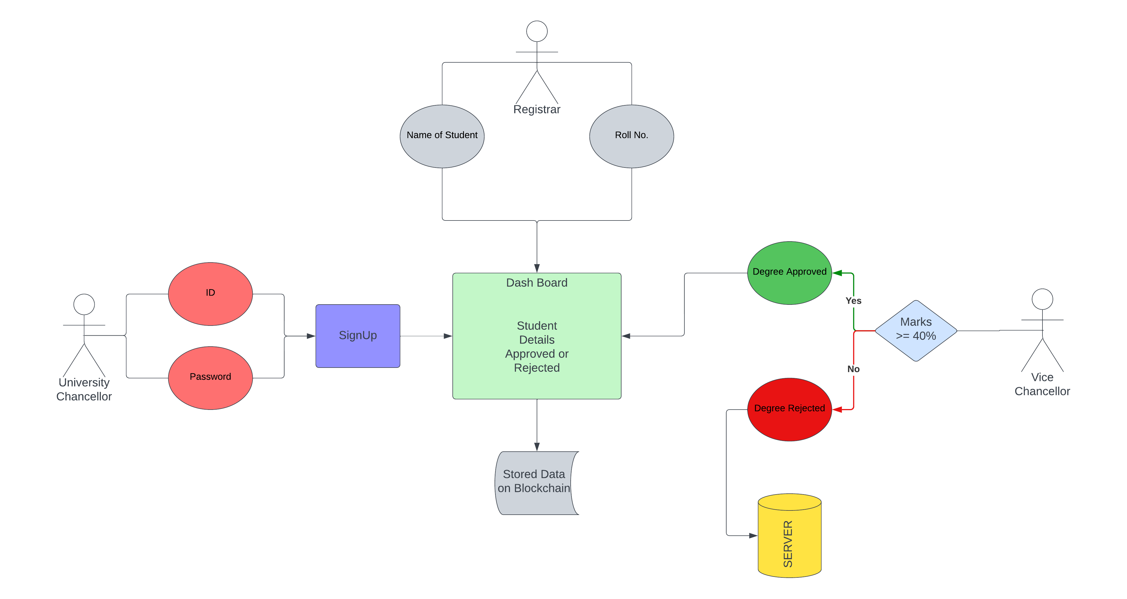
ER DIAGRAM

Slide 12

Technologies to be used
Front-End :--
ReactJS
CSS
HTML
Back-End :--
Solidity
NodeJS

Slide 13

advantages
Enhanced Trust: The project bolsters trust in academic qualifications and credentials by offering a secure and tamper-proof verification system. This, in turn, builds trust among employers, educational institutions, and individuals.
Reduced Fraud: By leveraging blockchain's immutability and transparency, the project significantly reduces the risk of fraudulent degrees and credentials, protecting organizations from hiring unqualified individuals.
Efficiency: The system streamlines the verification process, making it faster and more efficient than traditional methods, which often involve manual checks and delays.
Privacy Protection: Advanced cryptographic techniques safeguard user privacy, ensuring that only necessary information is disclosed during the verification process, enhancing data security.
User Empowerment: Individuals have control over their own credentials and can easily access and share them when needed, reducing the administrative burden on educational institutions

Slide 14

conclusion
Key Takeaways:
Blockchain technology offers a secure and transparent solution for credential verification.
Our project "Fake Degree Detection Based on Blockchain" addresses the pressing issue of fake academic credentials.
It enhances trust, reduces fraud, and streamlines verification processes.
Impact:
Empowers individuals, educational institutions, and employers.
Protects the integrity of academic qualifications.
Paves the way for a more reliable and efficient ecosystem.
Future Promise:
Potential for global adoption and industry integration.
Continuous improvement in security and user experience.
A long-lasting positive influence on education and employment practices.
Thank You:
We look forward to a future where trust and authenticity prevail in the realm of academic qualifications.

Slide 15

Thank you

